Slide 1
Digital Marketing Automation POC on InvokanaCarepath 18-Dec-2013

Slide 2
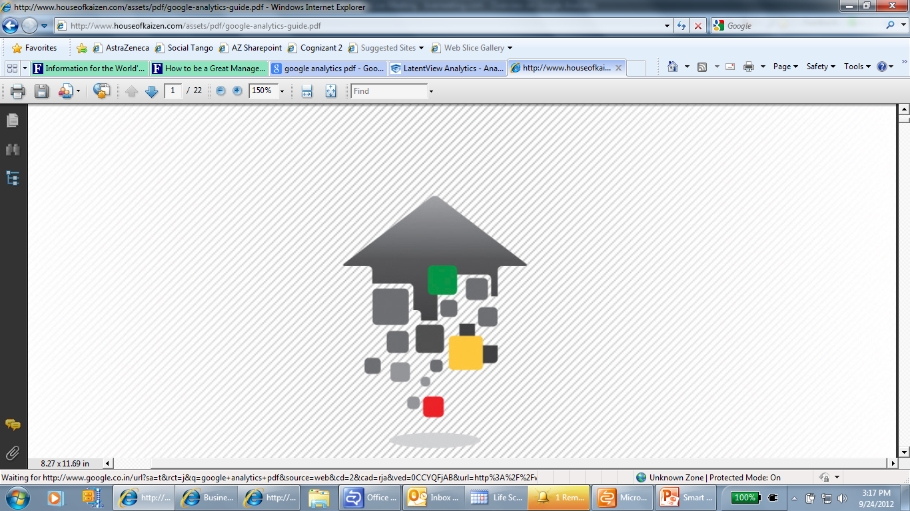
Agenda
1
Context
2
Current and Recommended state
3
Comparison matrix – Quick Test Professional Vs Selenium
4
Test demo
5
Test results
6
Automation Approach
7
Implementation roadmap
8
Cognizant Solutions & Value adds

Slide 3
Context
Manual testing of Invokana care path Phase 1 and Phase 2 test execution is complete. The time and effort required to do functional regression testing for small code changes during minor releases is too high
There is a need to have an regression suite, automation of regression suite is required to reap in following benefits with good Quality
Faster execution time
Higher coverage through automation
Reduced cycle time
Higher customer confidence due to the increased coverage
Lesser chances of manual errors

Slide 4
Current State
Recommended State
Invokana Carepath application consists of 65 various user registration flows with approximately 1000 functional test steps.
Higher testing cost
Higher test cycle time
Time required to execute 65 test cases is – 1 week
Content and text verification done manually across browsers
Complete automation regression suite to test the future release testing
Comprehensive automation regression suite
Reduced test cycle time
Reduced testing cost
Accelerated and efficient regression test execution
Flexible regression test model to accommodate changing business needs
To reduce manual efforts and errors
Cross browser testing through automation

Slide 5
Comparison Matrix – Qtp versus Selenium
Category | Quick Test Professional 11.0 | Selenium 2.0 | Remarks
Reusability(%) | Reusability % is independent of tool | Reusability % is independent of tool | Reusability % depends on the application.
Content Verification on Static Sites / Pages | Static content(text ) verification is possible | Static content(text ) verification is possible | Text embedded with image is not possible.(ex: text present on saving card)
Page layout & styling | Below attributes can be tested : Font- family ,size ,height ,color ,weight ,text-align | Below attributes can be tested : Font- family,size,height,color ,weight ,text-align | Spacing between the frames and radio buttons is a challenge
User Interface to run test scripts | User can easily run the test scripts | User can easily run the test scripts | __
Browsers | Tool supports IE 8,9,10 and Chrome 19.0,Firefox 17.0 | Tool supports IE,Firefox,Chrome,Safari | __
Operating System | Supports Windows operating system | Supports Windows,Mac,Linux operating system | __
Mobile Platforms | Supports with third party plugin | Supports with external configuration | __
Automatic Run | Possible with Qtp | Possible with selenium | __
Batch execution | Possible with Qtp | Possible with selenium | Batch execution is possible but in sequential manner, Not like that all the scripts will run in parallel at a time in all the 300+ sites
Subset of Test scripts with good user interface | Possible with Qtp | Possible with Selenium | __
Functional features | Can be automated with Qtp | Can be automated using selenium | __
PDF contents | PDF automation is possible with Qtp by using external plug-in | PDF automation is not possible by using selenium | __
Video player and controls | It is not possible with Qtp | It is not possible with Selenium | __
Non functional features | It is not possible with Qtp | It is not possible with Selenium | __

Slide 6
Test Scenarios for Demo
Quick Test Professional - 11.0
User Registration Flow – Positive scenario
User Registration Flow – Error validation
Selenium – 2.0
User Registration Flow – Positive scenario
Functional Test Flows

Slide 7

Test Results
Quick Test Professional – 11.0
User Registration Flow – Positive scenario
User Registration Flow – Error Validation
Selenium – 2.0
User Registration Flow – Positive scenario

Slide 8
Quick Test Professional – Pros & Cons
Advantages of Using QTP
The Test results are more reliable
JNJ Approved Tool
In-Built Data base connectivity access, Which helps in database testing
It provides advanced solution for both functional and regression test automation
Automation scripts are executed within the specific interval of time using task scheduler/crone job
Excellent Object Identification process/mechanism
Many inbuilt functionalities by default with easy configuration
Disadvantages of Using QTP
Supports Windows based operating system
Supports only 3 browsers( IE, Firefox and Chrome) with limited browser versions
High licensing and add-ins costs
Slow in execution when compared with open source tools

Slide 9
Selenium – Pros & Cons
Advantages of Using Selenium
Cost effective as it is open source
Simple and powerful document object model (DOM) level testing, can be used for continuous integration with agile projects
Supports multiple browsers such as Internet Explorer, Fire fox, Safari or Opera with respective to versions on Windows, Mac OS X and Linux operating systems
Supports Object Oriented Programming languages like JAVA, .NET, Ruby, Perl, PHP, etc
Provides the option of using wide range of IDEs such as Eclipse, Net beans, Visual Studio etc. depending on the choice of development language
Disadvantages of Using Selenium
Supports only browser based application, Not the stand alone/desktop application
Provides only partial support for dialog boxes
The efforts involved in scripting for Selenium increased by about 15 % than QTP in the initial stages
Does not support file uploads from local machine
Being an open source, Selenium has no official technical support
It is not JNJ approved tool

Slide 10
Automation Approach
POC Phase
Core Automation Phase
Sprint 1
Sprint 2
Sprint 3
Sprint N
Functional Testing Sprint 2
Functional Testing Sprint 3
…..
Functional Testing Sprint 1
Functional Testing Sprint N
Automation
Automation: Sprint 1
Automation: Sprint 2
Automation: Sprint N-1
Proof-of-Concept (POC)
Planning & Analysis
Planning & Analysis
Planning & Analysis
Script Design & Development
Script Design & Development
Script Design & Development
Script Execution
Script Execution
Script Execution
Review, Rework & Closure
Review, Rework & Closure
Review, Rework & Closure
Continuous Improvements & Regression Suite Maintenance
Deliverables
POC report
Automation Framework
Reusable components
Automation Suite
Execution summary Report
Reusable components
Automation Suite
Execution summary Report
Reusable components
Automation Suite
Execution summary Report

Slide 11
Implementation Roadmap
Testing Activities
Implementation
Existing
Function al Test Cases
Technical overview of the application
Access privileges
Feasibility analysis of the application
Identify Manual Functional Test cases for automation
Developing reusable functions
Developing application specific functions
On Boarding process and KT
Design new test scripts using CRAFT / CRAFT Lite
Setup Environment & Tool Configuration
Dry run the test scripts
Review and approve the test scripts
Automation Activities

Slide 12
Cognizant Solution and Benefits
Cognizant Solution
Effective test Automation through usage of in-house developed CRAFT/ CRAFT Lite automation framework.
Execution of the Regression suite for every release.
Customized report generation in HTML .
Strict design control and review process for the automation artifacts.
Testing team was effectively guided by specific subject matter experts (SMEs) during the course of the project .
Value Adds/ Benefits to the Client
Frequent changes in each sprint of the application was seamlessly managed by the CRAFT/CRAFT Lite framework resulting in low maintenance.
Both CRAFT / CRAFT Lite frameworks has more generic features and can be used as per vendor choice.
Batch execution can be performed by which no manual intervention is required till the execution of the whole batch.
50 % reusability of automation scripts drastically reduced timelines.
Providing the results to the client in Three formats QTP Results , Excel Results, HTML Results.

Slide 13
Comparison Matrix – Quick Test Professional Vs Selenium
Category | Focus Areas | HP Quick Test Professional 11 | Selenium - Web Driver
General
 | Technology Support | Web, Delphi, Java, .Net , Oracle, SAP, Siebel, PowerBuilder, TE, Web2.0, WPF. | Support available only for web based applications
 | Platform Support | Windows | Windows, Linux, Mac
 | Browser Support | IE, FF and Chrome | WebDriver - IE, FF, Chrome, Safari
Test Design
 | Record and Playback | Yes | Yes (With Selenium IDE on FF)
 | Supported Programming/Scripting Languages | VB Scripts | C#, Java, Perl, PHP, Python, Ruby
 | Ease of test design | Basic scripting knowledge is required | Expert knowledge required to leverage the advanced features of Selenium
 | Basic Data Driven Testing capabilities | Yes | Not available out-of-the-box. But can be comprehensively implemented using the programming language or frameworks
 | Exception Handling & Recovery | Basic features available | Not available out-of-the-box. But can be comprehensively implemented using the programming language or frameworks
 | Support of custom controls/extensibility | Yes | Partial
 | IDE capabilities | Basic | Based on the language, features of IDEs like Eclipse

Slide 14
Comparison Matrix ….Continued
Category | Focus Areas | HP Quick Test Professional 11 | Selenium - Web Driver
UI Map Management
 | UI Map Manager | Easy to use editor, Object Repository Manager with shared object repositories | No Object Repository Support. Appropriate design patterns like UIMap, Page Object Model should be used
 | UI Object Spy | Built-in Object Spy to learn object properties | No. Need to leverage tools like Firebug, IE Dev toolbar etc.
Test Execution & Reporting
 | Ease of debugging and Execution | Simple, right from QTP | To happen from the IDE of the respective language
 | Reporting | Detailed Results Viewer | Not available out-of-the-box. But can be comprehensively implemented using the programming languages or frameworks
Integrations
 | Continuous Integration | ALI plug ins are available to integrate with Continuous integration tools like Jenkins | Yes. Plug-ins are ava liable for CC, Hudson, Jenkins
 | Integration with commercial Test Management Tools like Quality Center | Yes. Integrates with Quality Center | Not available out-of-the-box

Slide 15
Comparison Matrix…Continued
Category | Focus Areas | HP - Quick Test Professional 11.0 | Selenium – Web Driver
Training and Documentation
 | Learning Curve | Small | High
 | Automated Tester Requirement | Functional tester may be able to develop and execute automated test cases with basic scripting skills. | Use of Selenium requires some programming experience for leveraging all the powerful features of the tool.
 | Script Development Effort | Relatively easy to design tests | Script development time is proportional to the proficiency in the respective programming language
 | Script Maintenance Effort | Varies based on the automation framework and methodology. | Varies based on the automation framework and methodology.
 | Documentation | Comprehensive support documentation from HP | Basic documentation available in the open source community and forums
Cost & Support
 | Cost | High | Free and Open Source Tool
 | Technical Support | Professional product support available | Backed by the open source community
Testware
 | Tools required for automation | QTP | Selenium IDE (Basic Recording), Selenium RC/WebDriver, Fire Bug/IE Developer Toolbar, Programming Language Development Kit and respective IDE
Cognizant’s Solution Accelerators
 | Test Automation Frameworks | CRAFT, CRAFTLite | CRAFT, CRAFTLite with Page Object Model, UI Map design patterns

Slide 16
Thank You…

